Slide 1
Milestones Review
Science & Social Studies

Slide 2
SCIENCE

Slide 11
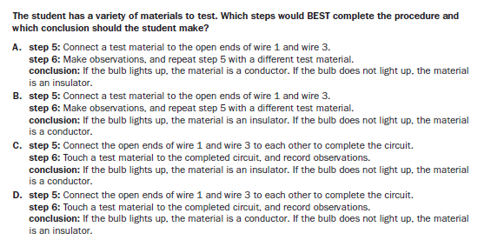

Slide 43
Social Studies

Slide 66
